Slide 1
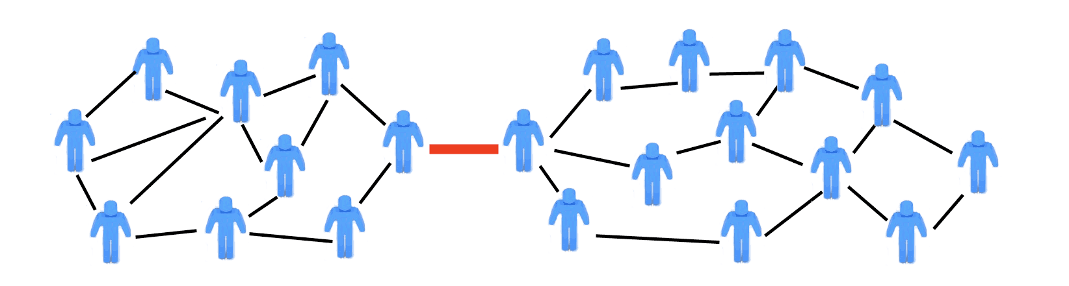
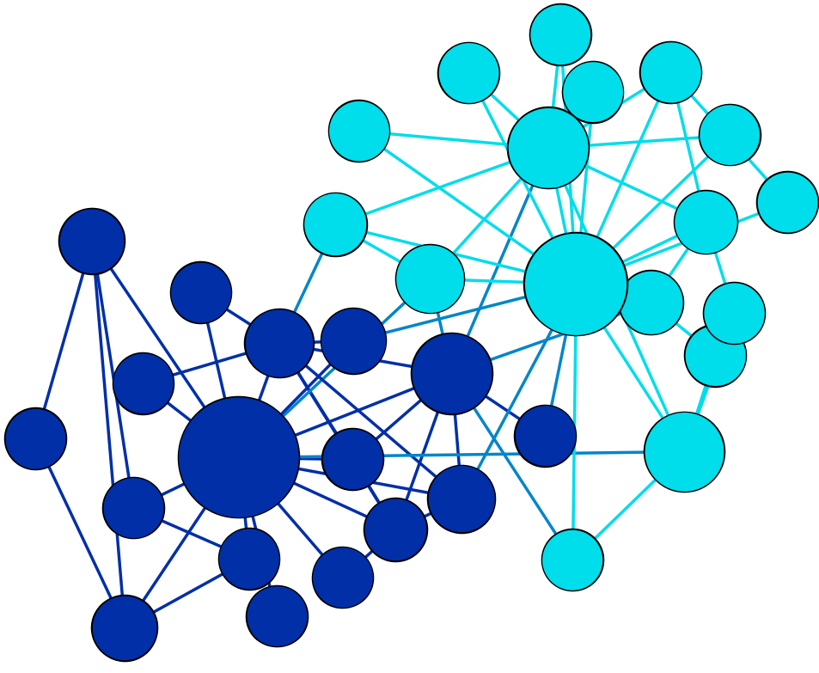
Community Detection
Modularity and Greedy Community Detection
&
Modularity

Slide 2
Modularity
Modularity- measures the quality of each partition (or community).
Modularity allows us to decide if a particular community partition is better than some other one.
Modularity optimization also offers an approach for community detection.

Slide 3
Modularity
Consider a network with N nodes and L links and a partition into n_{c} communities.
Each community having N_{c} nodes connected to each other by L_{c} links, where c=1,...,n_{c}. If L_{c} is larger than the expected number of links between the N_{c} nodes given the network’s degree sequence.
Then the nodes of the subgraph C_{c} could indeed be part of a true community, as expected based on the Density Hypothesis H2.
H2: Connectedness and Density Hypothesis.

Slide 4
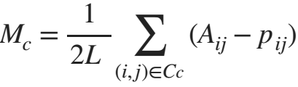
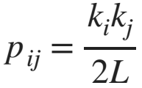
Modularity
Modularity:
Here p_{ij} can be determined by randomizing the original network, while keeping the expected degree of each node unchanged.

Slide 5
Modularity
Modularity:
If M_{c} is positive: the subgraph C_{c} has more links than expected by chance, hence it represents a potential community.
If M_{c} is zero: the connectivity between the N_{c} nodes is random, fully explained by the degree distribution.
If M_{c} is negative: the nodes of C_{c} do not form a community.

Slide 6
Modularity
H3: Random Hypothesis
Randomly wired networks lack an inherent community structure.
This hypothesis has some actionable consequences.
By comparing the link density of a community with the link density obtained for the same group of nodes for a randomly rewired network.
We could decide if the original community corresponds to a dense subgraph, or its connectivity pattern emerged by chance.

Slide 7

Modularity
Modularity:
$=2Lp_{i}p_{j}$
$p_{i}=\frac{k_{i}}{2L}$ , $p_{j}=\frac{k_{j}}{2L}$
Original data
Expected connections

Slide 8
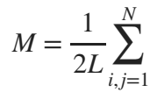

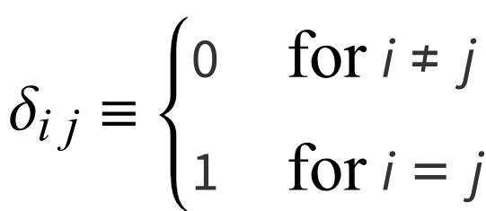
Modularity
Modularity as a Sum Over Communities:
Kronecker delta function

Slide 9
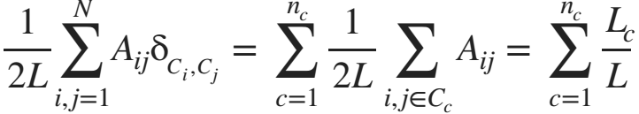
Modularity
Modularity as a Sum Over Communities:
where C_{i} is the label of the community to which node i belongs to. As only node pairs that belong to the same community contribute to the sum.
we can rewrite the first term as a sum over communities:
where L_{c} is the number of links within community C_{c}. The factor 2 disappears because each link is counted twice in A_{ij}.

Slide 10
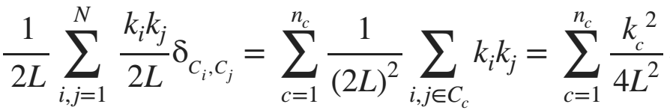
Modularity
In a similar fashion the second term is rewritten as:
where k_{c} is the total degree of the nodes in community C_{c}. Indeed, in the configuration model the probability that a stub connects to a randomly chosen stub is 1/2L, as in total we have 2L stubs in the network.
Hence the likelihood that our stub connects to a stub inside the module is k_{c}/2L. By repeating this procedure for all k_{c} stubs within the community C_{c} and adding 1/2 to avoid double counting, we obtain the last term

Slide 11
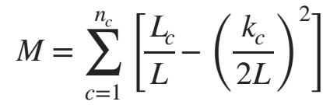
Modularity
Modularity as a Sum Over Communities:
Combining both the terms,
we got a simpler form of modularity:

Slide 12
Modularity
Modularity has several key properties:
Higher Modularity Implies Better Partition
The higher is M for a partition, the better is the corresponding community structure.
The modularity of a partition cannot exceed one.
Zero and Negative Modularity
By taking the whole network as a single community we obtain M=0.
If each node belongs to a separate community, we have Lc=0 and the sum has nc negative terms, hence M is negative.

Slide 13
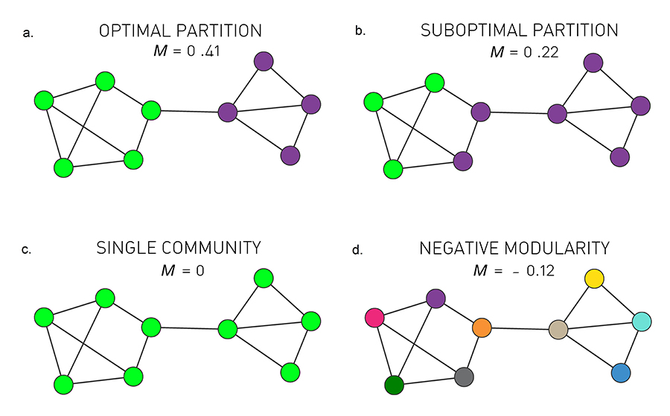
Modularity
Optimal Partition
The partition with maximal modularity M=0.41 closely matches the two distinct communities.
Suboptimal Partition
A partition with a sub-optimal but positive modularity, M=0.22, fails to correctly identify the communities present in the network.

Slide 14
Modularity
Single Community
If we assign all nodes to the same community we obtain M=0, independent of the network structure.
Negative Modularity
If we assign each node to a different community, modularity is negative, obtaining M= - 0.12.

Slide 15
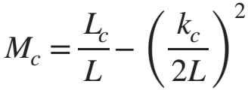
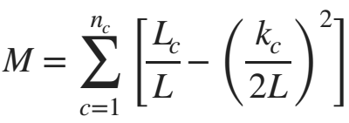
Modularity
Simpler form for the modularity:
where L_{c} is the total number of links within the community C_{c} and k_{c} is the total degree of the nodes in this community.
The modularity of the whole network can be defined by summing the modularity of all n_{c} communities

Slide 16
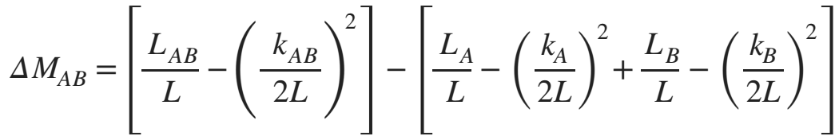


Modularity
Merging Two Communities:
Consider communities A and B and denote with k_{A} and k_{B} the total degree in these communities.
We wish to calculate the change in modularity after we merge these two communities. Using simpler form of modularity, this change can be written as:
Where
is the number of direct links between the nodes of communities A and B.

Slide 17

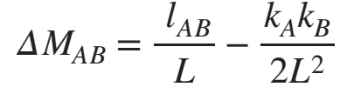
Modularity
Merging Two Communities:
Consider communities A and B and denote with k_{A} and k_{B} the total degree in these communities.
We wish to calculate the change in modularity after we merge these two communities. Using simpler form of modularity, this change can be written as:
After inserting both the equations into change in modularity equation, we obtain:

Slide 18
Modularity
Modularity Summary:
We can use modularity to decide which of the many partitions predicted by a hierarchical method offers the best community structure, selecting the one for which M is maximal.
Modularity for each cut of the dendrogram, finds a maximum to break the network into good communities.
Simpler form for the modularity:

Slide 19
The Greedy Algorithm
H4: Maximal Modularity Hypothesis
For a given network the partition with maximum modularity corresponds to the optimal community structure.

Slide 20
The Greedy Algorithm
The first modularity maximization algorithm, proposed by Newman, iteratively joins pairs of communities if the move increases the partition's modularity.

Slide 21
The Greedy Algorithm
The algorithm follows these steps:
Assign each node to a community of its own, starting with N communities of single nodes.
Inspect each community pair connected by at least one link and compute the modularity difference ΔM obtained if we merge them. Identify the community pair for which ΔM is the largest and merge them. Note that modularity is always calculated for the full network.
Repeat Step 2 until all nodes merge into a single community, recording M for each step.
Select the partition for which M is maximal.

Slide 22

Limits of Modularity
Resolution Limit:
Modularity maximization forces small communities into larger ones.
Modularity maximization cannot detect communities that are smaller than the resolution limit.
Resolution limit (total degree of the communities)
Real networks contain numerous small communities.
Given the resolution limit, these small communities are systematically forced into larger communities, offering a misleading characterization of the underlying community structure.

Slide 23
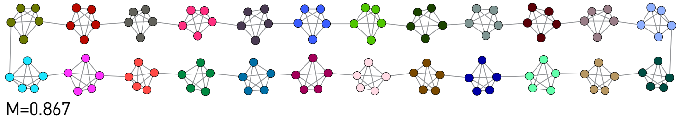
Limits of Modularity
A ring network consisting of 24 cliques, each made of 5 nodes.
The Intuitive Partition:
The best partition should correspond to the configuration where each cluster is a separate community. This partition has M=0.867

Slide 24
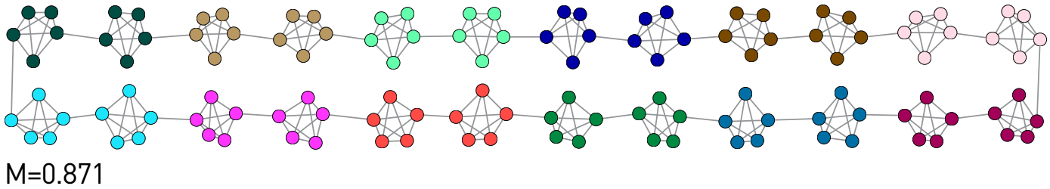
Limits of Modularity
The Optimal Partition:
If we combine the clusters into pairs, as illustrated by the node colors, we obtain M=0.871, higher than M obtained for the intuitive partition.

Slide 25
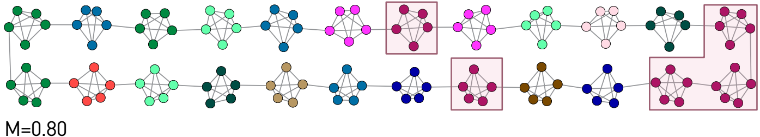
Limits of Modularity
Random Partition:
Partitions with comparable modularity tend to have rather distinct community structure.
For example, if we assign each cluster randomly to communities, even clusters that have no links to each other, like the five highlighted clusters, may end up in the same community.
The modularity of this random partition is still high, M=0.80, not too far from the optimal M=0.87

Slide 26
Overlapping Communities
A node is rarely confined to a single community.
In real networks communities are often overlap.
Tamás Vicsek and collaborators proposed an algorithm to identify overlapping communities, bringing the problem to the attention of the network science community.
we will discuss two algorithms to detect overlapping communities:
Clique Percolation
Link Clustering

Slide 27
Overlapping Communities: Clique Percolation
The clique percolation algorithm, often called Cfinder, views a community as the union of overlapping cliques.
Two k-cliques are considered adjacent if they share k – 1 nodes.
A k-clique community is the largest connected subgraph obtained by the union of all adjacent k-cliques.
k-cliques that can not be reached from a particular k-clique belong to other k-clique communities.
The CFinder algorithm identifies all cliques and then builds an N_{clique} x N_{clique} clique–clique overlap matrix O.
where N_{clique} is the number of cliques and
O_{ij} is the number of nodes shared by cliques i and j.

Slide 28
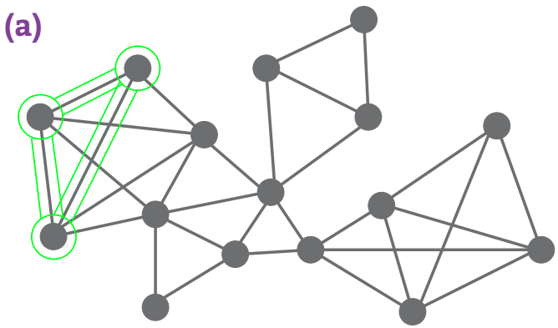
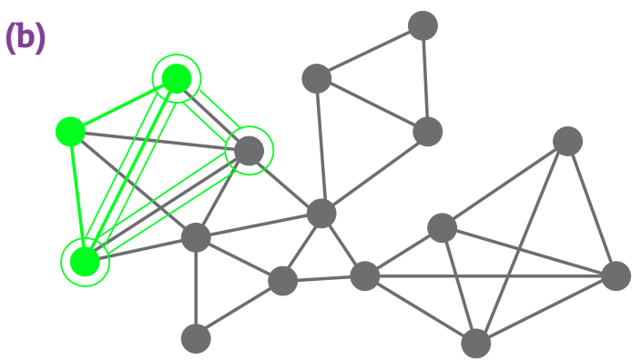
Overlapping Communities: Clique Percolation
Example:
To identify k=3 clique-communities we roll a triangle across the network, such that each subsequent triangle shares one link (two nodes) with the previous triangle.
(a)-(b) Rolling Cliques
Starting from the triangle shown in green in (a), (b) illustrates the second step of the algorithm.

Slide 29
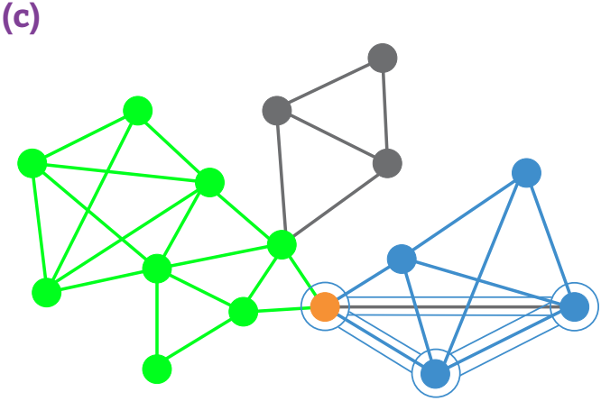
Overlapping Communities: Clique Percolation
(c) Clique Communities for k=3.
The algorithm pauses when the final triangle of the green community is added. The green community has been completed.
Note that there can be multiple k-clique communities. We illustrate this by showing a second community in blue. The figure highlights the moment when we add the last triangle of the blue community. The blue and green communities overlap, sharing the orange node.

Slide 30
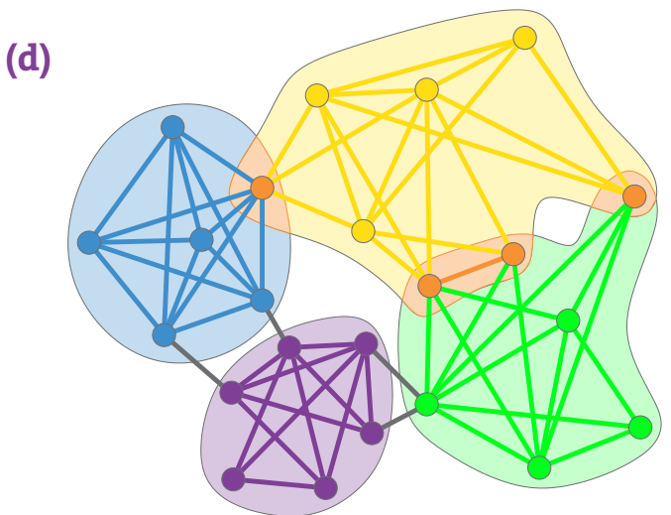
Overlapping Communities: Clique Percolation
(d) Clique Communities for k=4
k=4 community structure of a small network, consisting of complete four node subgraphs that share at least three nodes. Orange nodes belong to multiple communities.

Slide 31
Overlapping Communities: Clique Percolation
Computational Complexity:
Finding cliques in a network requires algorithms whose running time grows exponentially with N.
Yet, the CFinder community definition is based on cliques instead of maximal cliques, which can be identified in polynomial time.
If, however, there are large cliques in the network, it is more efficient to identify all cliques using an algorithm with O(e^{N}) complexity.

Slide 32
Overlapping Communities: Link Clustering
While nodes often belong to multiple communities, links tend to be community specific, capturing the precise relationship that defines a node’s membership in a community.
The link clustering algorithm proposed by Ahn, Bagrow and Lehmann consists of the following steps:
Step 1: Define Link Similarity
Step 2: Apply Hierarchical Clustering

Slide 33
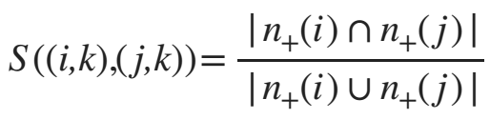
Overlapping Communities: Link Clustering
Step 1: Define Link Similarity:
The similarity of a link pair is determined by the neighborhood of the nodes connected by them.
Consider for example the links (i,k) and (j,k), connected to the same node k. Their similarity is defined as:
where n₊(i) is the list of the neighbors of node i, including itself.

Slide 34
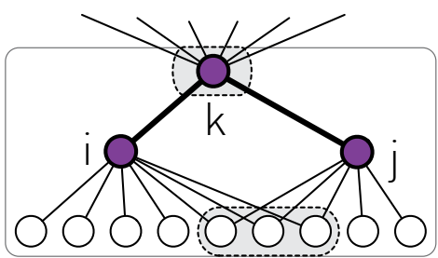
Overlapping Communities: Link Clustering
Step 1: Define Link Similarity:
The similarity S of the (i,k) and (j,k) links connected to node k detects if the two links belong to the same group of nodes.
Denoting with n₊(i) the list of neighbors of node i, including itself, we obtain |n₊(i)∪n₊(j)| =12 and
|n₊(i)∩n₊(j)| =4,
So, S = 1/3

Slide 35
Overlapping Communities: Link Clustering
Step 1: Define Link Similarity:
Hence S measures the relative number of common neighbors i and j have.
Consequently S=1 if i and j have the same neighbors. The less is the overlap between the neighborhood of the two links, the smaller is S

Slide 36
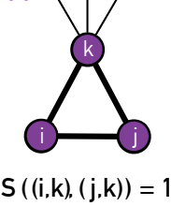
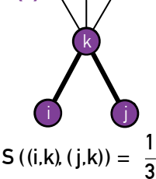
Overlapping Communities: Link Clustering
S=1 if i and j have the same neighbors.
The less is the overlap between the neighborhood of the two links, the smaller is S.

Slide 37
Overlapping Communities: Link Clustering
Step 2: Apply Hierarchical Clustering:
The similarity matrix S allows us to use hierarchical clustering to identify link communities.
We use a single-linkage procedure, iteratively merging communities with the largest similarity link pairs.

Slide 38
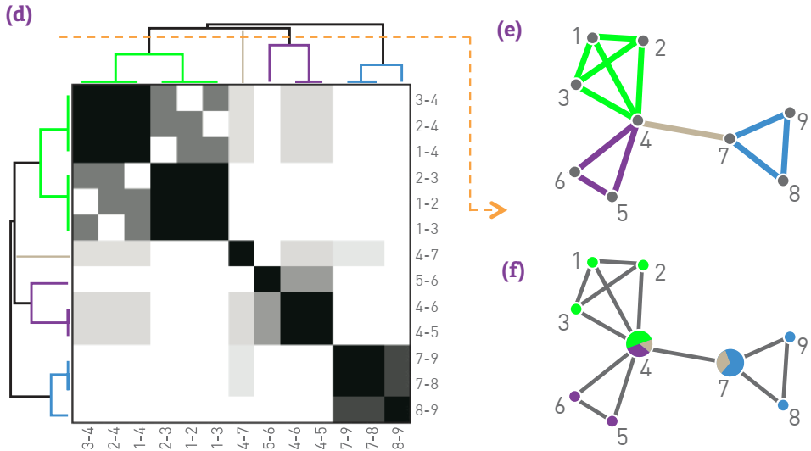
Overlapping Communities: Link Clustering
Example:
The figure shows the link dendrogram.
The link similarity matrix for the network shown in (e) and (f). Darker entries correspond to link pairs with higher similarity S.
The link community structure predicted by the cut of the dendrogram shown as an orange dashed line in (d).
The overlapping node communities derived from the link communities shown in (e).

Slide 39
Overlapping Communities: Link Clustering
Computational Complexity:
The link clustering algorithm involves two time-limiting steps: similarity calculation and hierarchical clustering.
Calculating the similarity for a link pair with degrees k_{i} and k_{j} requires max(k_{i},k_{j}) steps.
For a scale-free network with degree exponent γ the calculation of similarity has complexity O(N^{2/(γ-1)}), determined by the size of the largest node, k_{max}.
Hierarchical clustering requires O(L2) time steps.
Hence the algorithm's total computational complexity is O(N^{2/(γ-1)})+ O(L²).
For sparse graphs the latter term dominates, leading to O(N²).

Slide 40
Fast Algorithms for Community Detection
The algorithms discussed so far were chosen to illustrate the fundamental ideas and concepts pertaining to community detection.
Consequently, they are not guaranteed to be neither the fastest nor the most accurate algorithms.
Two popular fast algorithms (Louvain algorithm and Infomap), as their accuracy is comparable to the accuracy of the algorithms covered previously but offers better scalability.
Consequently, we can use fast algorithms to identify communities in very large networks.

Slide 41
Fast Algorithms for Community Detection
There are many similarities between the two algorithms:
They both aim to optimize a quality function Q . For the Louvain algorithm Q is modularity, M, and
For Infomap Q is an entropy-based measure called the map equation or L.
Both algorithms use the same optimization procedure.

Slide 42
The Louvain Algorithm
The greedy algorithm not perform good for very large networks.
Blondel and collaborators proposed the Louvain algorithm, which is a modularity optimization algorithm with better scalability.
The Louvain algorithm consists of two steps that are repeated iteratively:
Modularity Optimization
Community Aggregation

Slide 43
The Louvain Algorithm
Step I:
Start with a weighted network of N nodes, initially assigning each node to a different community.
For each node i we evaluate the gain in modularity if we place node i in the community of one of its neighbors j.
We then move node i in the community for which the modularity gain is the largest, but only if this gain is positive.
If no positive gain is found, i stays in its original community.
This process is applied to all nodes until no further improvement can be achieved, completing Step I.

Slide 44
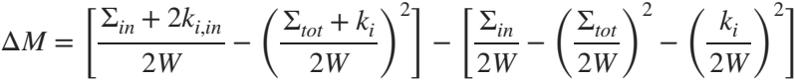
The Louvain Algorithm
Step I:
The modularity change ΔM obtained by moving an isolated node i into a community C can be calculated using
Σ_{in} is the sum of the weights of the links inside C (which is L_{C} for an unweighted network);
Σ_{tot} is the sum of the link weights of all nodes in C;
k_{i} is the sum of the weights of the links incident to node i;
k_{i,in} is the sum of the weights of the links from i to nodes in C and
W is the sum of the weights of all links in the network.

Slide 45
The Louvain Algorithm
Step II:
We construct a new network whose nodes are the communities identified during Step I.
The weight of the link between two nodes is the sum of the weight of the links between the nodes in the corresponding communities.
Links between nodes of the same community lead to weighted self-loops.
Once Step II is completed, we repeat Steps I - II, calling their combination a pass.
The number of communities decreases with each pass.
The passes are repeated until there are no more changes and maximum modularity is attained.

Slide 46
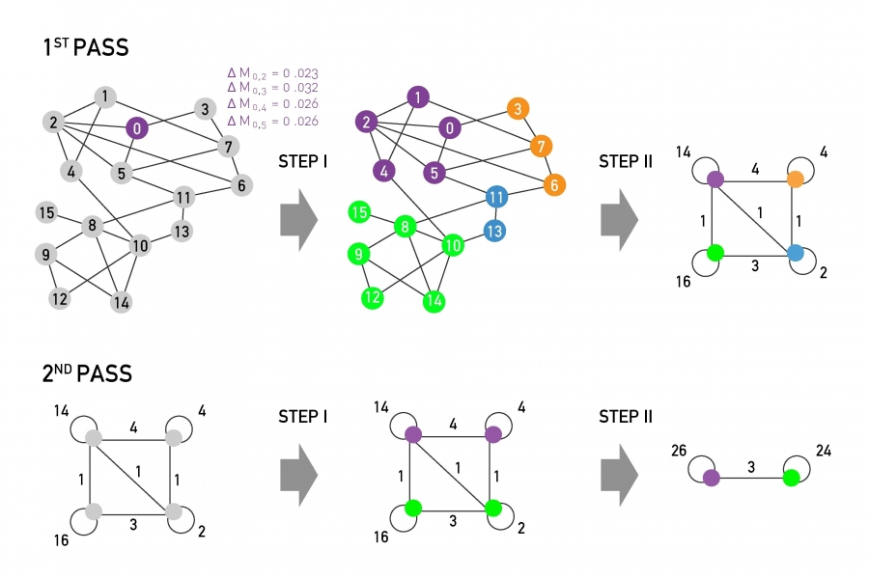
The Louvain Algorithm
Step I:
Modularity is optimized by local changes. We choose a node and calculate the change in modularity, if the node joins the community of its immediate neighbors.
The figure shows the expected modularity change ΔM_{o,i} for node 0. Accordingly node 0 will join node 3, as the modularity change for this move is the largest, being ΔM_{0,3}=0.032.
This process is repeated for each node, the node colors corresponding to the resulting communities, concluding Step I.

Slide 47
The Louvain Algorithm
Step II:
The communities obtained in Step I are aggregated, building a new network of communities. Nodes belonging to the same community are merged into a single node, as shown on the top right.
This process will generate self-loops, corresponding to links between nodes in the same community that are now merged into a single node.
The sum of Steps I & II are called a pass. The network obtained after each pass is processed again (Pass 2), until no further increase of modularity is possible.

Slide 48
The Louvain Algorithm
Computational Complexity:
The Louvain algorithm is more limited by storage demands than by computational time.
The number of computations scale linearly with L for the most time consuming first pass.
With subsequent passes over a decreasing number of nodes and links, the complexity of the algorithm is at most O(L).
It therefore allows us to identify communities in networks with millions of nodes.

Slide 49
Infomap
Introduced by Martin Rosvall and Carl T Bergstrom, Infomap exploits data compression for community identification.
The map equation does it by optimizing a quality function for community detection in directed and weighted networks.

Slide 50
References
Theory:
M.E. J. Newman, Networks: An Introduction, Oxford University Press, 2010
Albert Barabasi, Network Science , Cambridge University Press, 2016
https://www.ic.unicamp.br/~meidanis/courses/mo412/2021s2/
https://www.dcc.fc.up.pt/~pribeiro/aulas/ns2021
Ravasz, https://www.science.org/doi/epdf/10.1126/science.1073374
Lab:
https://networkx.org/documentation/stable/tutorial.html
https://tedboy.github.io/networkx/

